Slide 1
Drowsiness Detection System
Submitted in the partial fulfillment for the award of the degree of
BACHELOR OF ENGINEERING
IN
BIG DATA ANALYTICS
Submitted by:
K.Lohith Kumar 20BCS3880
K.Rajashekar Reddy 20BCS3953
Under the Supervision of:
Shweta (E12791)
Department of AIT-CSE
DISCOVER . LEARN . EMPOWER

Slide 2
Outline
Introduction to Project
Problem Formulation
Objectives of the work
Methodology used
Results and Outputs
Conclusion
Future Scope
References

Slide 3
Introduction
Road safety is a significant problem in today's fast-paced environment.
Driving while intoxicated puts other drivers and the driver themselves in danger and is a leading cause of accidents.
The development of improved driver assistance systems has become critical in order to address this issue. One example is the "Drowsiness Detection System."
Drowsiness detection is a system which uses computer vision to detect a person’s drowsiness state.
It is a system which monitors persons state of eyes. Specifically, how long a person is closing his eyes.
Based on a timer of closing eyes, the system alerts the person by an alarm.

Slide 4
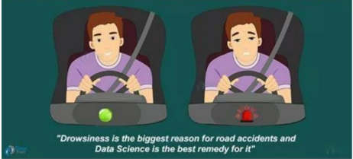
A threshold value of time is set in advance to the system. When the system outreach the threshold value then a corresponding action is taken out.
It is a very simple yet effective way for notifying people what state they are in, at various places.
More importantly, in situations like driving and monitoring for security.

Slide 5
Problem Formulation
The challenge is to create a system that can notice when someone starts looking really tired, like when they blink slowly or start nodding off.
To develop a computer vision-based system for drowsiness detection to enhance safety in activities like driving by identifying and alerting individuals who are becoming dangerously drowsy.
We're using cameras and sensors to watch for signs of tiredness, like how someone's eyes move or if they're moving their head differently.

Slide 6
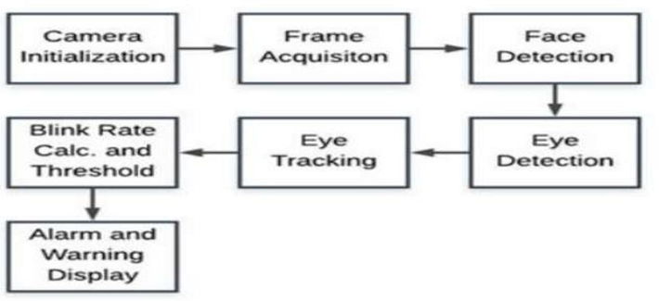
Preliminary Design of the project
Fig. 1. Design of the Project

Slide 7
Objectives of the Work
Creating a system where drowsiness of person is detected and alerted.
Making the system more efficient than the previous existing system.
Customizing the system considering various real life situations.
Improving the system’s accuracy on detecting and alerting quickly.
Preparing a research paper on this system.

Slide 8
Methodology
Data Collection:
Gather a dataset of images or videos containing individuals in various states of alertness and drowsiness.
Annotate the dataset to label each image or frame as alert or drowsy.
Data Preprocessing:
Resize all images or frames to a consistent size.
Normalize pixel values to a standard range (e.g., [0, 1] or [-1, 1]).
Split the dataset into training, validation, and testing sets.

Slide 9
Model Training:
Initialize the CNN model with appropriate weights (random or pre-trained).
Define a loss function (e.g., binary cross-entropy) and an optimizer (e.g., Adam).
Train the model on the training dataset.
Monitor training progress with metrics like accuracy and loss.
Implement early stopping to prevent overfitting.
Model Evaluation:
Evaluate the trained model on the validation set to fine-tune hyperparameters.
Adjust learning rate, batch size, or model architecture based on validation performance.
Repeat this process until the model performs well on the validation set.

Slide 10
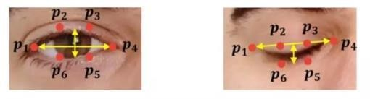
Face Detection:
Use another Haar Cascade Classifier or face detection algorithm to detect faces in the input frames.
Extract the region of interest (ROI) around the detected eyes within the detected face region.
Integrate the eye classification model with the Haar Cascade-based face and eye detection.
Implement logic to determine drowsiness based on the classification results (e.g., consecutive closed eyes over time).
Develop an alert mechanism, which can be audio, visual, or haptic, to notify the driver or user when drowsiness is detected.

Slide 11
Deployment:
Deploy the drowsiness detection system in a real-time or offline environment.
Integrate it with appropriate hardware (e.g., cameras) for real-time monitoring.

Slide 12
Feature/characteristics Identification
Blink Frequencies
Eye Closure Patterns
Facial Expressions
Real Time Processing

Slide 13
Constraint Identification
Data Privacy and Ethics
Accuracy vs. False Positives
Extended Training Time
Integration with Existing Systems
Ambient Conditions
Individual Variability

Slide 14
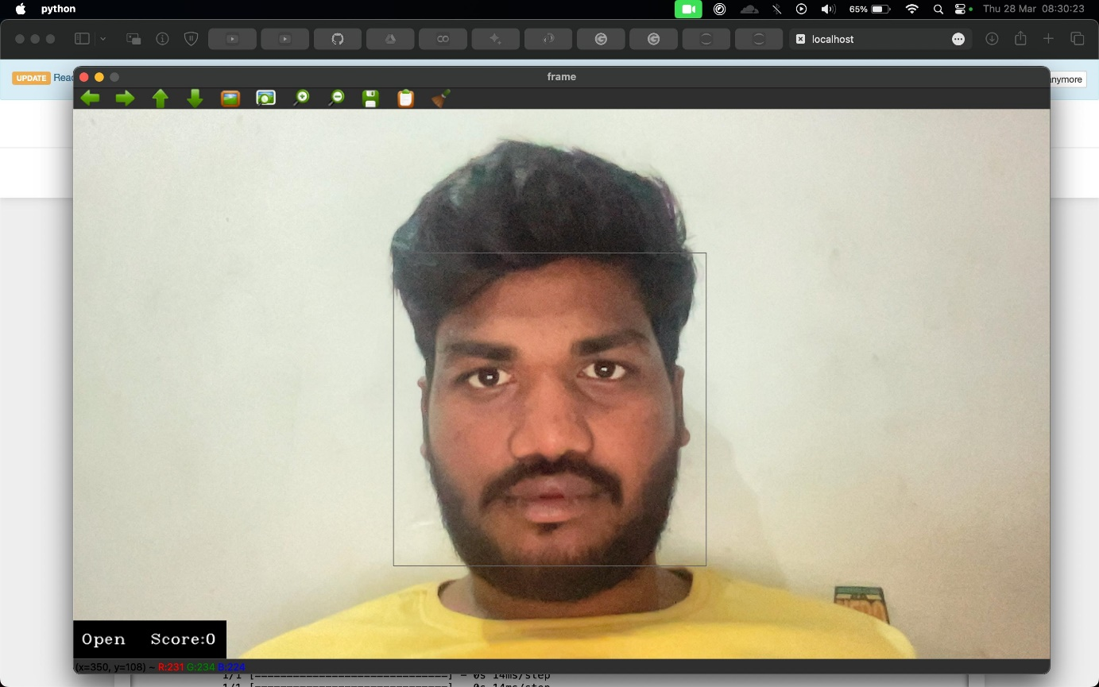
Results and Outputs
In the above image the user with open EYE lids are detected by the Camera thus no alarms will be activated

Slide 15
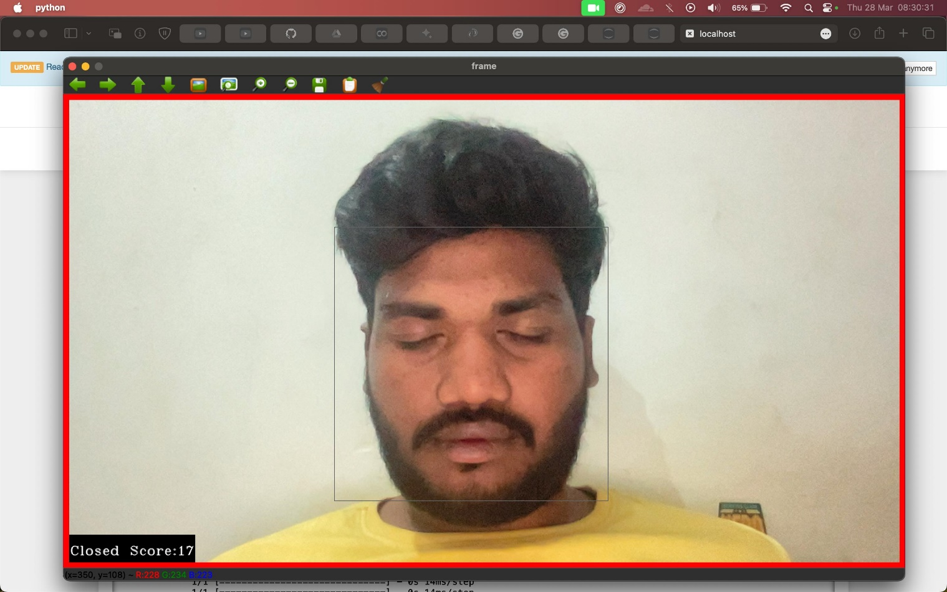
In this image the user with closed Eye lids Was detected thus therefore the alarm's will be activated

Slide 16
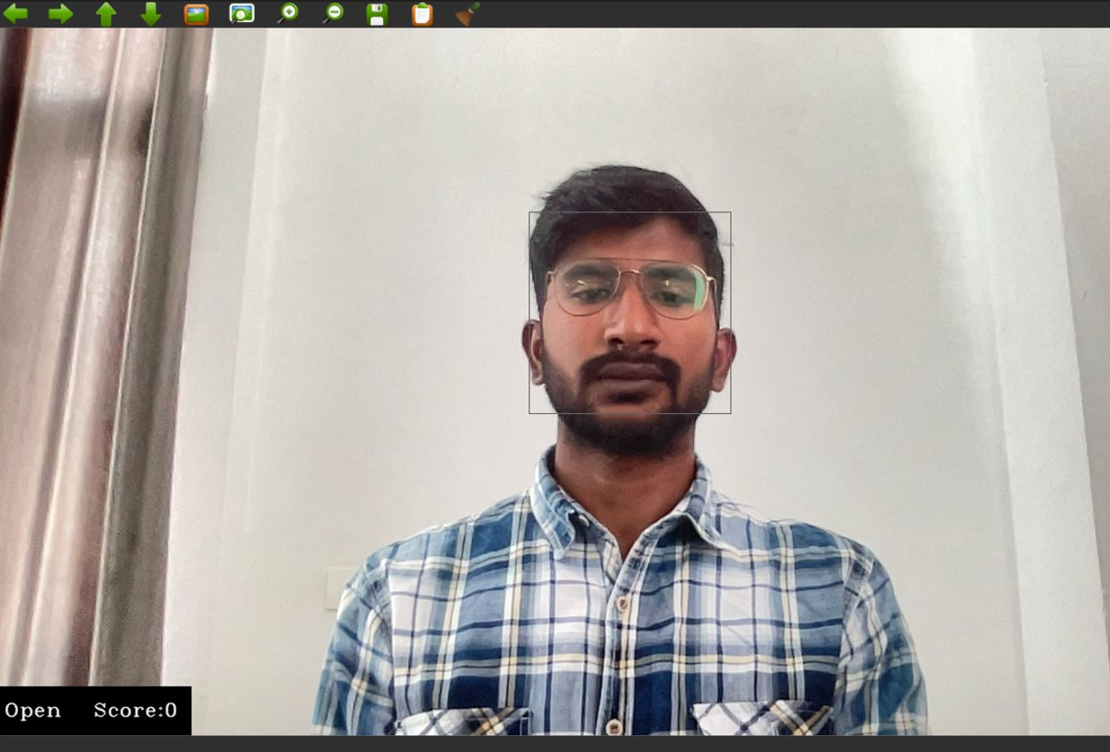
Now, the example of detecting the eyes with wear glasses and the eyes were open so score is ‘0’

Slide 17
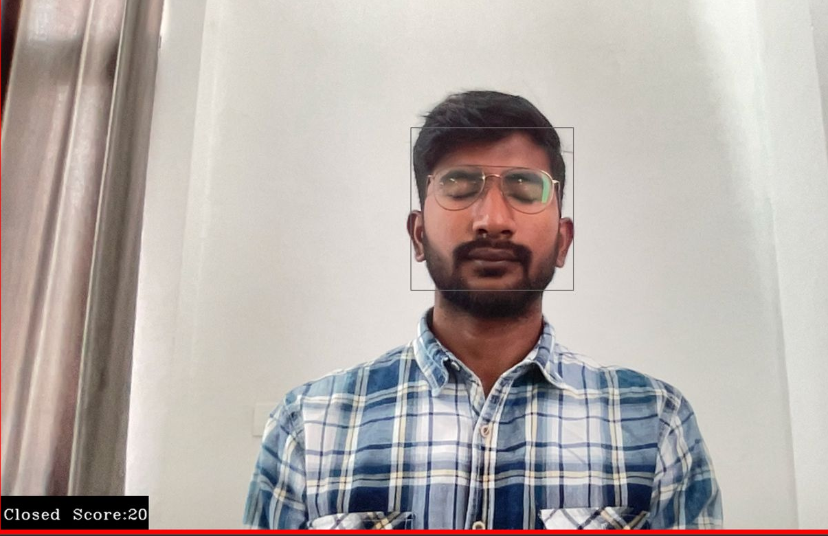
The score is ‘15’ which is greater than the set score value so the alarm will beep .

Slide 18
Individual | Ear Threshold | Alarm Sensitivity | Light | Remarks | Drowsiness Detection
A | 0.2 | 45 | Bright | Normal | 3 out of 3
A | 0.2 | 45 | Dim | Normal | 3 out of 3
A | 0.15 | 45 | Bright | Normal (closed) | 3 out of 3
B | 0.24 | 45 | Bright | Wearing Glasses | 3 out of 3
B | 0.24 | 45 | Dim | Wearing Glasses | 3 out of 3
C | 0.22 | 45 | Bright | Sun glasses | 0 out of 3
C | 0.22 | 47 | Very Dim | Night Drive | 2 out of 3
C | 0.14 | 47 | Bright | Sun glasses (closed) | 0 out of 3

Slide 19
Conclusion
1. Successful Classification:The analysis demonstrates the model's proficiency in accurately identifying non-drowsy drivers, indicating its effectiveness in discerning alertness levels. This success suggests promising potential for enhancing driver safety systems by providing timely interventions when drowsiness is detected.
2. Challenges with Misclassifications: Instances of misclassifications primarily stem from variations in lighting conditions and external factors affecting facial landmark detection. Understanding these challenges is crucial for refining the model and improving its robustness in real-world scenarios.
3. Key Features for Detection: By examining influential features such as eye closure patterns, head position variations, and blink frequencies, the analysis identifies critical factors contributing to accurate drowsiness detection. This insight informs the development of more sophisticated algorithms tailored to specific indicators of drowsiness.
4. Real-world Impact: The exploration of real-world applications underscores the practical significance of the research findings. The potential to mitigate the risk of accidents due to driver fatigue highlights the importance of advancing drowsiness detection technologies for improving overall driver safety.

Slide 20
Future Scope
The drowsiness detection system holds great potential for future advancements and expansion. Here are some possible future scopes for this project:
1. Enhanced Accuracy: Continuously improving the accuracy of the drowsiness detection system is a key future scope. This can be achieved by refining the feature extraction techniques, exploring more advanced machine learning or deep learning models, and incorporating additional contextual information such as heart rate or driving behavior.
2. Multimodal Approach: Integrating multiple modalities, such as audio and physiological signals, can provide a more comprehensive understanding of drowsiness. Combining facial analysis with voice analysis or biosensors can enhance the system's accuracy and enable early detection of drowsiness.
3. Personalization and Adaptation: Developing personalized models that adapt to individual characteristics and behaviors is an important future direction. Customizing the system based on user-specific data and preferences can lead to more accurate and personalized drowsiness detection, improving its effectiveness in real-world scenarios.
4. Real-Time Intervention: Expanding the system's capabilities to include real-time intervention is a promising future scope. For example, integrating the system with smart wearable devices or vehicle control systems to automatically initiate actions, such as alerting the driver or adjusting the environment, can prevent accidents caused by drowsiness.
5. Integration with IoT and Smart Environments: Integrating the drowsiness detection system with Internet of Things (IoT) devices and smart environments can create a networked ecosystem for drowsiness monitoring. This can enable seamless integration with smart homes, smart cars, or workplace environments, providing a comprehensive safety solution.

Slide 21
References
[1] Ali, R., & Wang, D. (2021). Driver drowsiness detection using deep learning: A comprehensive review. IEEE Access, 9, 19642-19664.
[2] Mohan, S., & Thirumalai, K. (2020). A comprehensive review on drowsiness detection using machine learning techniques. International Journal of Advanced Science and Technology, 29(3), 2479-2486.
[3] Liang, J., & Li, X. (2020). A comprehensive review on driver drowsiness detection systems using machine learning and deep learning techniques. IEEE Access, 8, 125540-125558.
[4] Nguyen, L. T., & Nguyen, T. D. (2020). Driver drowsiness detection using deep learning techniques: A comprehensive review. IEEE Access, 8, 76396-76412.
[5] Adhinata, F.D.; Rakhmadani, D.P.; Wijayanto, D. Fatigue Detection on Face Image Using FaceNet Algorithm and K-Nearest Neighbor Classifier. J. Inf. Syst. Eng. Bus. Intell. 2021, 7, 22–30.
[6] Gwak, J., Hirao, A., Shino, M.: An investigation of early detection of driver drowsiness using ensemble machine learning based on hybrid sensing. Appl. Sci. 10(8), 2890 (2020)
[7] Kepesiova, Z., Ciganek, J., Kozak, S.: Driver drowsiness detection using convolutional neural networks. In: 2020 Cybernetics & Informatics (K&I) (2020).
[8] You, F., Li, X., Gong, Y., Wang, H., Li, H.: A real-time driving drowsiness detection algorithm with individual differences consideration. IEEE Access 7, 179396–179408 (2019).

Slide 22
[9] Sathasivam, S., Mahamad, A.K., Saon, S., Sidek, A., Som, M.M., Ameen, H.A.: Drowsiness detection system using eye aspect ratio technique. In 2020 IEEE Student Conference on Research and Development (SCOReD) (2020). [10] Abtahi, S., Omidyeganeh, M., Shirmohammadi, S., Hariri, B.: YawDD: yawning detection dataset. IEEE Dataport (2020). [11] Savas, B.K., Becerikli, Y.: Real time driver fatigue detection system based on multi-task ConNN. IEEE Access 8, 12491–12498 (2020). [12] Bavkar, S., Iyer, B., Deosarkar, S.: Rapid screening of alcoholism: an EEG based optimal channel selection approach. IEEE Access 7, 99670–99682 (2019). [13] Bavkar, S., Iyer, B., Deosarkar, S.: BPSO based method for screening of alcoholism. In: Kumar, A., Mozar, S. (eds.) ICCCE 2019. Lecture Notes in Electrical Engineering, vol. 570, pp. 47–53. Springer, Singapore (2020). [14] Deshpande, P., Iyer, B.: Research directions in the internet of every things (IoET). In: 2017 International Conference on Computing, Communication(ICCCA), Greater Noida, pp. 1353–1357 (2017).

